Slide 1
Noise Pollution Monitoring
Presented by
N.Sivaselvan
au730321106053

Slide 2


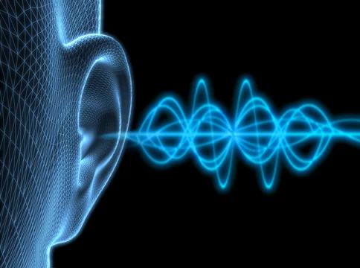

Using IoT to Develop Innovative Solutions

Slide 3
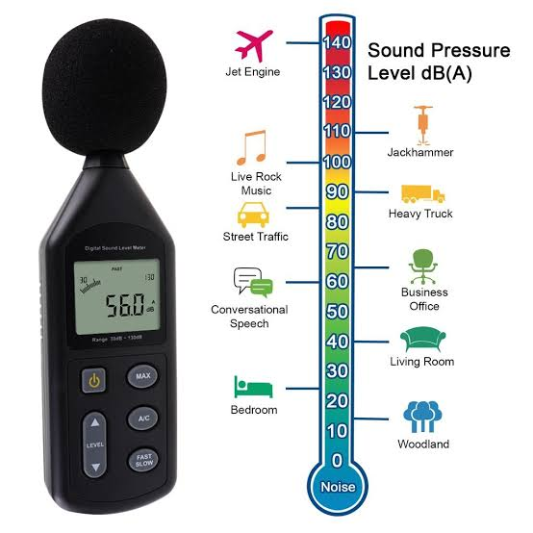
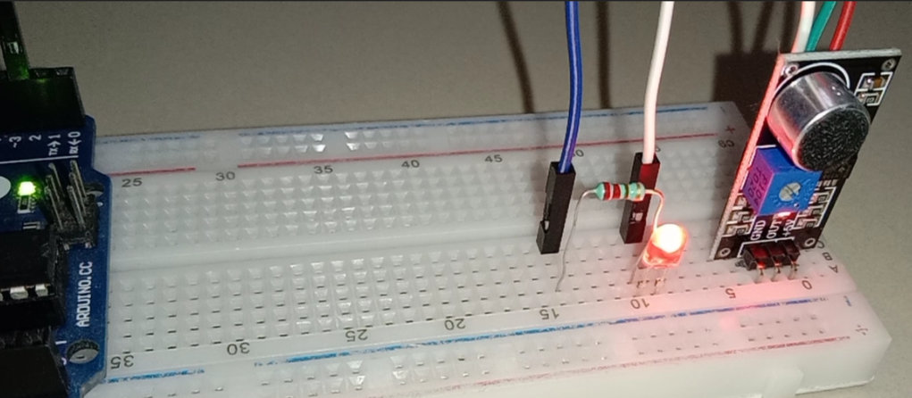
What is Noise Pollution?
Noise pollution is any excessive or unwanted sound that can have a negative impact on human health or well-being.
It can be caused by a variety of sources, including traffic, construction, industry, and aircraft.

Slide 4
Components operation
Piezo Noise Sensors
Explain the working principle of piezo noise sensors:
Conversion of mechanical vibrations (sound waves) into electrical signals.
High sensitivity to specific frequency ranges.
Ultrasonic Sensors
Describe the functionality of ultrasonic sensors:
Emitting ultrasonic waves and measuring their reflection.
Ideal for detecting high-frequency noise.
Noise monitoring
exposed to noise levels above 85db, it is important to wear earplugs and ermuffs to protect your hearing .
you should also take breaks from exposure to loud noises. If have any concerns about hearing

Slide 5
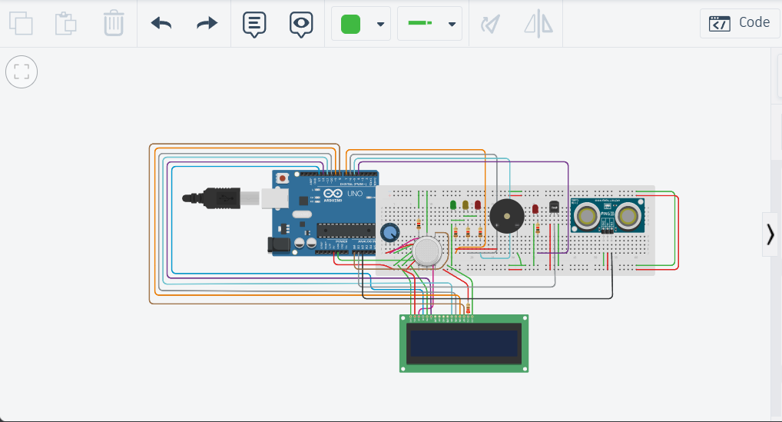
Noise pollution monitoring using arduino

Slide 6
Code </
// include the library code:
#include <LiquidCrystal.h>
// initialize the library with the numbers of the interface pins
LiquidCrystal lcd(13, 12, 11, 10, 9, 8);
int gasPin=A0;
int tempPin=A1;
int soundPin=A2;
int gasGreenLedPin=7;
int gasYellowLedPin=6;
int gasRedLedPin=5;
int soundRedLedPin=4;
int gasReading=0;
int soundReading=0;
int tempReading=0,temp1=0,temperature=0;
void scrollScreenSaver() {
lcd.clear() ;
lcd.setCursor(15, 0); // Set LCD cursor position (column 0, row 0)
lcd.print("Enjoy fresh air...");
// scroll 7 positions (display length - string length) to the left
// to move it back to center:
for (int positionCounter = 0; positionCounter < 25; positionCounter++) {
// scroll one position left:
lcd.scrollDisplayLeft();
// wait a bit:
delay(200);
}
}
void setup()
{
// set up the LCD's number of columns and rows:
lcd.begin(16, 2);
Serial.begin(9600);//reading through serial monitor
pinMode(gasGreenLedPin, OUTPUT);
pinMode(gasYellowLedPin, OUTPUT);
pinMode(gasRedLedPin, OUTPUT);
pinMode(soundRedLedPin, OUTPUT);
}

Slide 7
void loop()
{
gasReading=analogRead(gasPin);
Serial.println(gasReading);
digitalWrite(gasGreenLedPin,gasReading>100 ? HIGH : LOW);
digitalWrite(gasYellowLedPin,gasReading>200 ? HIGH : LOW);
digitalWrite(gasRedLedPin,gasReading>300 ? HIGH : LOW);
if(gasReading>100)
{
lcd.clear();
lcd.setCursor(15,0);
lcd.print("Air is polluted...");
for (int positionCounter = 0; positionCounter < 25; positionCounter++)
{
// scroll one position left:
lcd.scrollDisplayLeft();
// wait a bit:
delay(100);
}
}
soundReading=analogRead(soundPin);
Serial.println(soundReading);
long dB = (soundReading+83.2073) / 11.0034;
Serial.println(dB);
if(dB>60){
lcd.clear();
lcd.setCursor(15,0);
lcd.print("Sound is polluted...");
for (int positionCounter = 0; positionCounter < 25; positionCounter++) {
// scroll one position left:
lcd.scrollDisplayLeft();
// wait a bit:
delay(100);
}
}
else
{
scrollScreenSaver() ;
}
}

Slide 8
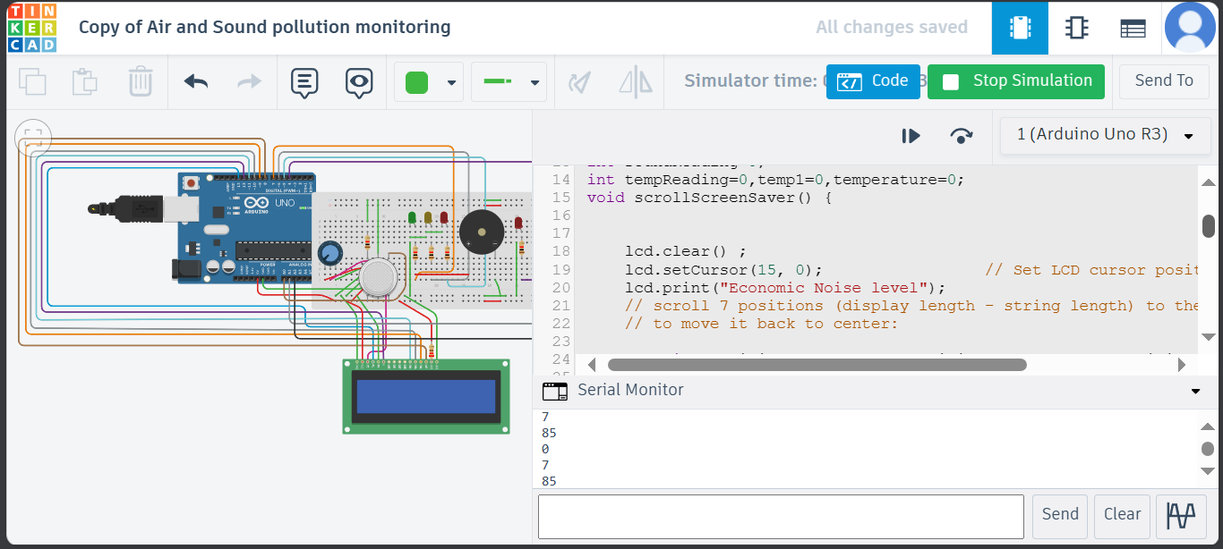
Simulation output (serial monitor)

